Slide 1









Curriculum
Presentation
Year 6

Slide 2
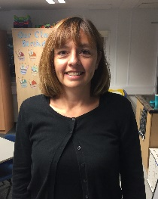
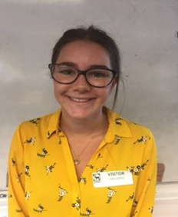
Year 6 Teachers
Mrs Bricknell
6B
Miss Surridge
6S

Slide 3
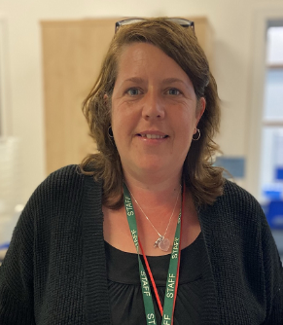
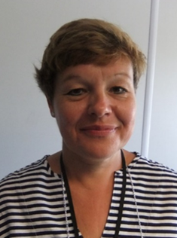
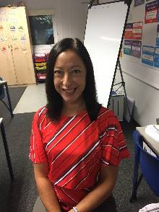
Year 6 Support Staff
Ms Brassett
Mrs Smith
Mrs Riabova

Slide 4
Year 6 Expectations
  Building independence
  Using their initiative
  Personal organisation
  Taking responsibility
  Learning from mistakes
  Growing in confidence
  Learning from our Stanley Values

Slide 5

Behaviour Expectations
High standards of behaviour expected in Y6, following our school values (you can find these on our website)
Good behaviour rewarded using house point system and class rewards

Slide 6

Values

Slide 7
Maths
Pupils will work in their classes. There will be a small support group running during these lessons.
We will follow White Rose Maths, which uses the mastery approach.
Mastering maths means pupils acquiring a deep, long-term, secure and adaptable understanding of the subject.

Slide 8
White Rose Maths
The main aims of the White Rose Maths scheme has new learning in year 6. Our main aims for this term are to:
recap essential content
begin the year six curriculum
assess the children’s learning and ensure appropriate support is provided (this will be through teacher assessment and end of topic tests).
PLEASE NOTE: we will be providing before school booster classes – this is by invitation only.

Slide 9
Maths Passports
These are used to assess the pupils’ key instant recall facts. They are important so children are prepared for coping with more complex problems. These skills will be practised in class and we would appreciate if you could support your child by practising these at home.
The targets for these are on the school website.

Slide 10
English - Writing
This will be taught in class groups using Jane Considine’s The Write Stuff.
Writing is based around core texts and project work.
Spelling is taught through the Spelling Book. Handwriting is taught and practiced weekly through Letter Join and interventions are run for groups of children.

Slide 11
English - Spelling
Spelling strategies and rules will be explicitly taught in lessons through the Spelling Book.
Y5 and 6 words are accessible on Google Classroom for children to practise.
Common spelling errors will be addressed (edited and rehearsed) as directed by the teacher’s feedback and marking.
Spelling interventions will run alongside class spelling lessons for those children who still require consolidation of prior learning in this area.

Slide 12
Reading
Reading is taught through Stanley Active Reading.
Reading records need to be completed weekly with at least one entry per week.
Intervention groups will be run to support children.
The skills we teach are:
Retrieval, vocabulary, inference, author’s choice, prediction, compare, contrast and comment.

Slide 13






Our Class texts

Slide 14
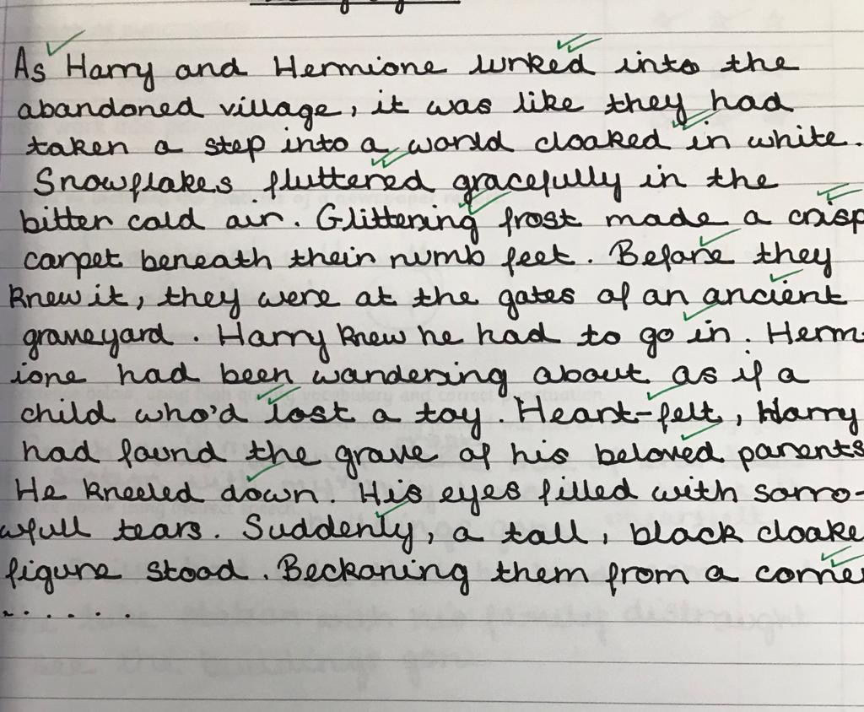
Handwriting and Presentation
neat presentation
in black pen (no biros)
neatly joined handwriting
use of ruler
tidy correction of errors

Slide 15



Our Timetable
MON
TUE
WED
THU
FRI
Homework due in
PE DAY
Homework handed out
PE DAY
Homework Club

Slide 16
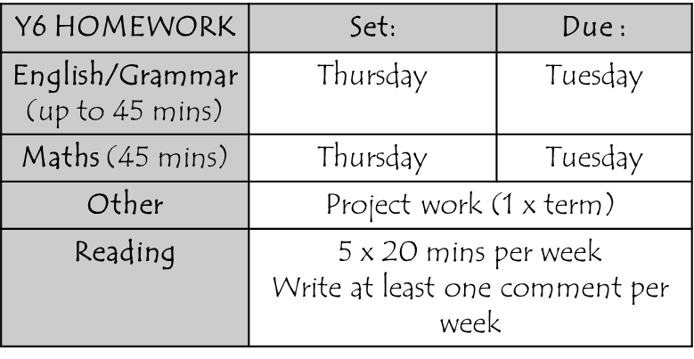
Regular practice of x table and division facts, and number bonds
Homework
Thursday – Tuesday
Maths and English
Creative homework to be given three times over the year.
Information for homework
will be posted on
Google Classroom.

Slide 17
Projects
Autumn 1: A Child’s War
Autumn 2: Frozen Kingdom
Spring 1: Darwin’s Delights
Spring 2: Blood Heart
Summer 1: Our Changing World
Summer 2: Hola! Mexico

Slide 18
Marking and Assessment
A range of marking techniques are used as follows:
  An in-depth commentary and/or target for development
  Peer-marking
  Self-marking
  Verbal feedback
  Children’s progress in maths and English will be assessed every half term.

Slide 19
SATs
w/b 10th – 13th May
Statutory Assessments
English tests (Reading, SPaG)
Maths tests (Arithmetic, Reasoning 1 and Reasoning 2)
Results conveyed to parents in end of year reports in July

Slide 20
Writing Assessments
Teacher assessed;
Assessed across a range of genres;
Working towards the expected standard, working at the expected standard and working at greater depth within the expected standard;
Children must demonstrate that they can write independently;
Children must be able to write in a neat, legible cursive script;
Emphasis on grammar, punctuation and spelling.

Slide 21
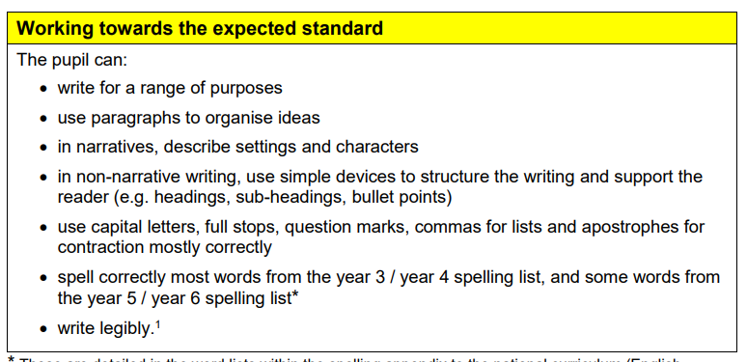

Slide 22
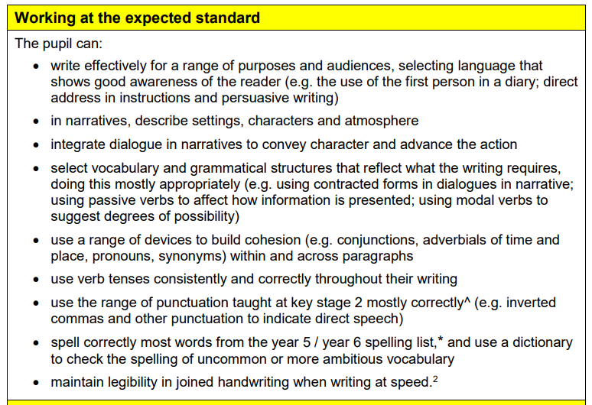

Slide 23
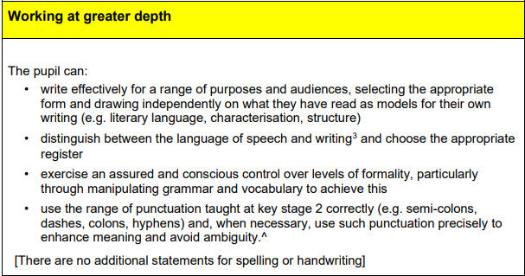

Slide 24


Online Safety and Safeguarding
Mobile phones will be kept by class teachers and are expected to be handed in every morning.
Parental checks on social media – monitoring your child’s activity online.
Parent conduct through messaging services – be considerate when using class chats.

Slide 25


The ban on all social media platforms for under 16s is due to come into force in Spring 2027. (Whatsapp will be excluded from this ban so children can still talk to family and friends).

Slide 26
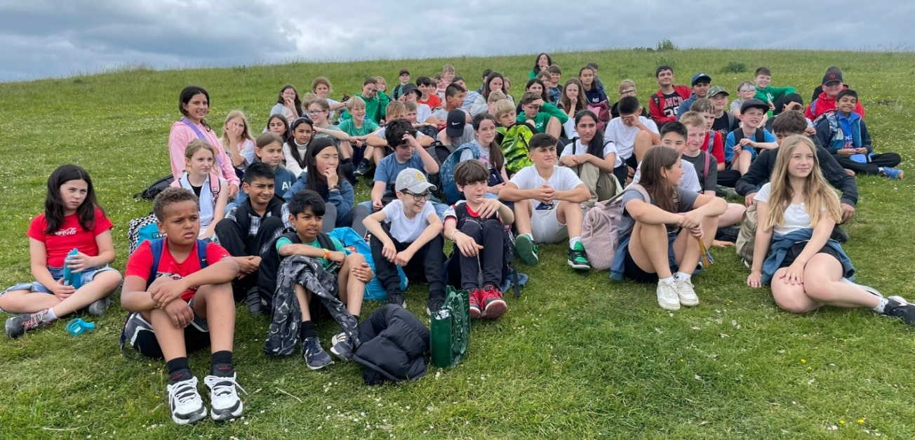
Osmington Bay – 7th to 11th June
There will be an information evening in the Spring term
If you have any queries or concerns, please speak to your child’s class teacher.
We will keep you updated of any changes as and when they happen.

Slide 27
Transition to Year 7
Use this link to find out more information about applying to secondary school.
The closing date for applying for a year 7 place is 31 October 2026.
Increased responsibility for homework
Developing independence and confidence
Transition unit followed in Summer Term
Junior Citizen – Friday 2nd October (children to be dropped at school by 8.30)

Slide 28
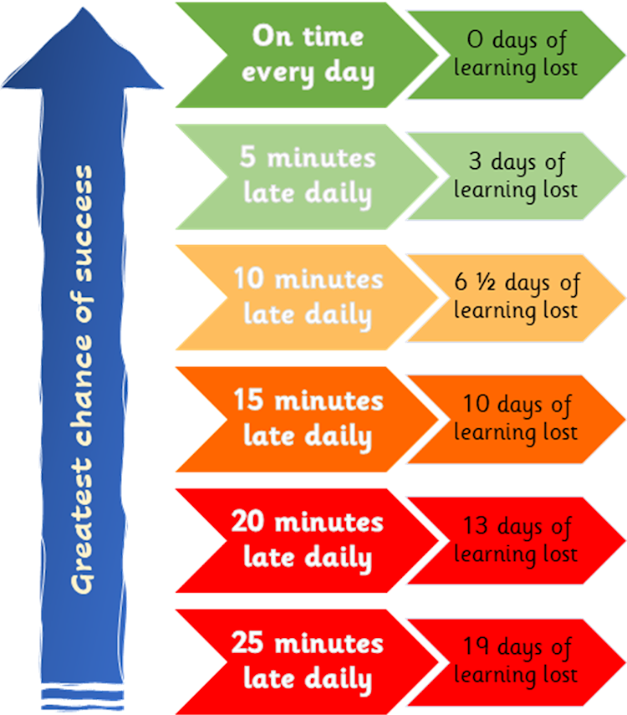
How can you help?
Reading
Practising times tables/mental maths skills
Support with homework
Punctuality
Equipment
Promote independence in order to develop confidence
Volunteering in school
We would appreciate any help you can offer us.

Slide 29
Communication
If you need to contact your child’s teacher, we would prefer you to use the year six email. year6@stanley.richmond.sch.uk We will aim to reply within two working days.
If you have an urgent message, you can pass it through TAs, during morning drop off, or write a note in your child’s reading record.
In case of emergency or absence, contact the office on 0208 977 4858.

Slide 30
Important dates
Junior Citizen – Friday 2nd October (children to be dropped at school by 8.30)
Evacuee day – Friday 16th October (tbc)
The closing date for applying for a year 7 place is 31 October 2026.
6B class assembly – Tuesday 20th October
Teddington School’s performance of Grease – Tuesday 1st December
6S class assembly – Thursday 4th February
SATs – 10th – 13th May
Bushy Park day – 14th May
Secondary school transition day – 5th July (TBC)
Leavers’ show – 13th & 14th July (Evening performance on 14th only)
Leavers’ assembly – Thursday 22nd July

Slide 31


Don’t forget evacuee day on 16th October! ☺

