Slide 1




Stanley Primary School
Welcome to Year 5!

Slide 2


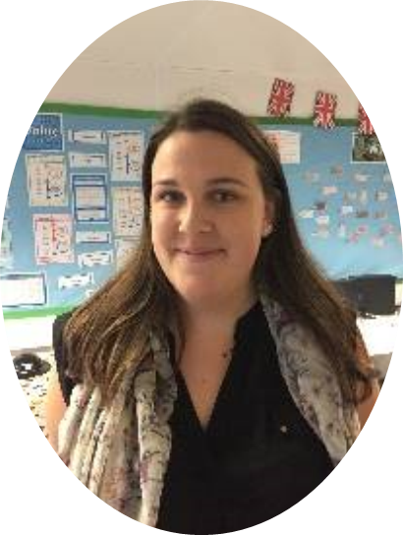
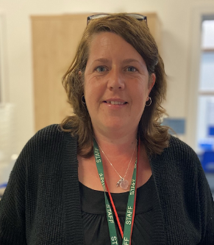
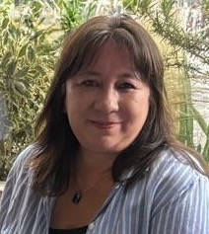

The team…
Miss Mitchell
Mrs Parsons
Ms Brassett

Slide 3

Year 5 expectations
  Independence
  Using their initiative
  Personal organisation
  Taking responsibility
  Learning from mistakes
  Growing into happy, confident individuals
  Learning from our Stanley Values

Slide 4



Marking system and assessment
Acknowledges the child’s efforts but objective not achieved
The objective has mainly been achieved.
The work has been completed and the objective has been achieved.
Also a range of marking techniques are used as follows:
The above
An in-depth commentary and/or target for development
Peer-marking
Self-marking
Children’s progress in maths and English will be formally assessed termly.

Slide 5


Equipment
Children will need to come in in correct PE kit on PE days.
Year 5 PE is on Thursday and Friday for all children.
Long hair tied back please and jewellery removed. Studs that cannot be removed need to be taped over.
Children need to provide their own pencil cases with resources to use in school.
A named water bottle - not too big please.
Please make sure that all equipment and uniform is clearly named!

Slide 6


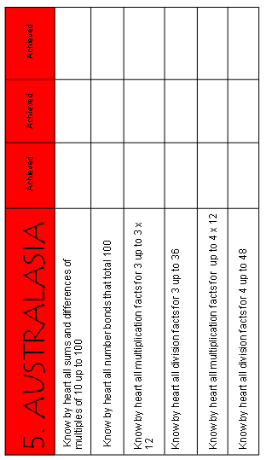
Maths
We use the ‘White Rose Maths’ scheme.
To make it easier for your child to access the learning more readily in these lessons, please help them to rehearse and learn the KIRFs (Key instant recall facts.)
The children will complete their passports regularly to support the learning of the KIRFS. Targets will be sent home in the next couple of weeks.

Slide 7

Writing
We teach writing using The Write Stuff approach.
The Write Stuff is a structured approach to teaching writing, developed by Jane Considine. It uses clear modelling, engaging lessons and the 'Three Zones of Writing' (initiate, model, enable) to help children develop their ideas, vocabulary and sentence structure.
In Year 5, we use this approach to build confidence, improve writing skills and support children in becoming more independent, creative writers.

Slide 8
Spelling
Spelling strategies and rules will be explicitly taught in lessons through the Jane Considine approach.
The Y5 and 6 statutory words are accessible on Google Classroom for children to practise.
Common spelling errors will be addressed (edited and rehearsed) as directed by the teacher’s feedback and marking.
RWI/ Fresh Start spelling intervention will run in addition to class spelling lessons for those children who still require consolidation of prior learning in this area.

Slide 9

Handwriting
In school, we follow the Letter-join handwriting scheme.
Letter-join is a whole school handwriting scheme offering a combination of traditional and digital resources. These include interactive animations, handwriting activities and online games.

Slide 10

Reading at school
The School uses ‘Stanley Active Reading’. This is an approach which allows whole-class teaching and learning of each specific reading comprehension skill. Where possible, texts are linked to other subject areas.
Key Reading Skills:
Retrieval
Prediction
Comparison
Summary
Vocabulary
Inference
Author’s choice

Slide 11






Class books
Children in Year 5 thoroughly enjoy the class texts.
English work relates closely to the book the class are reading together.

Slide 12
Reading at home
It is important that children read for understanding.
Any opportunity that allows you to listen to your child read, for example, doing the ironing and washing up, is a bonus!
Always ask questions to check their understanding.
Please encourage them to pick books from a variety of genres.
Children will be given a reading record, which they are expected to fill in regularly. The purpose is to develop their response to a book as well as their understanding.

Slide 13
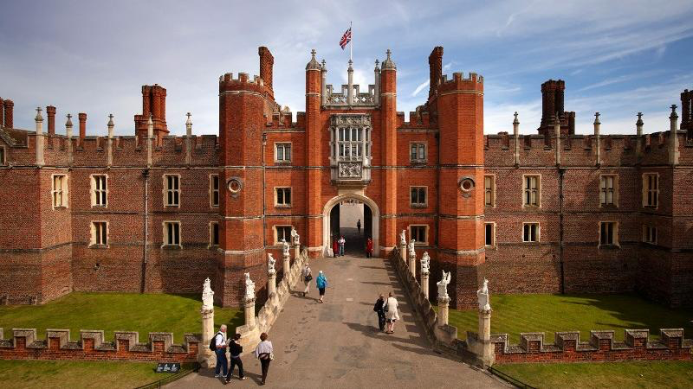
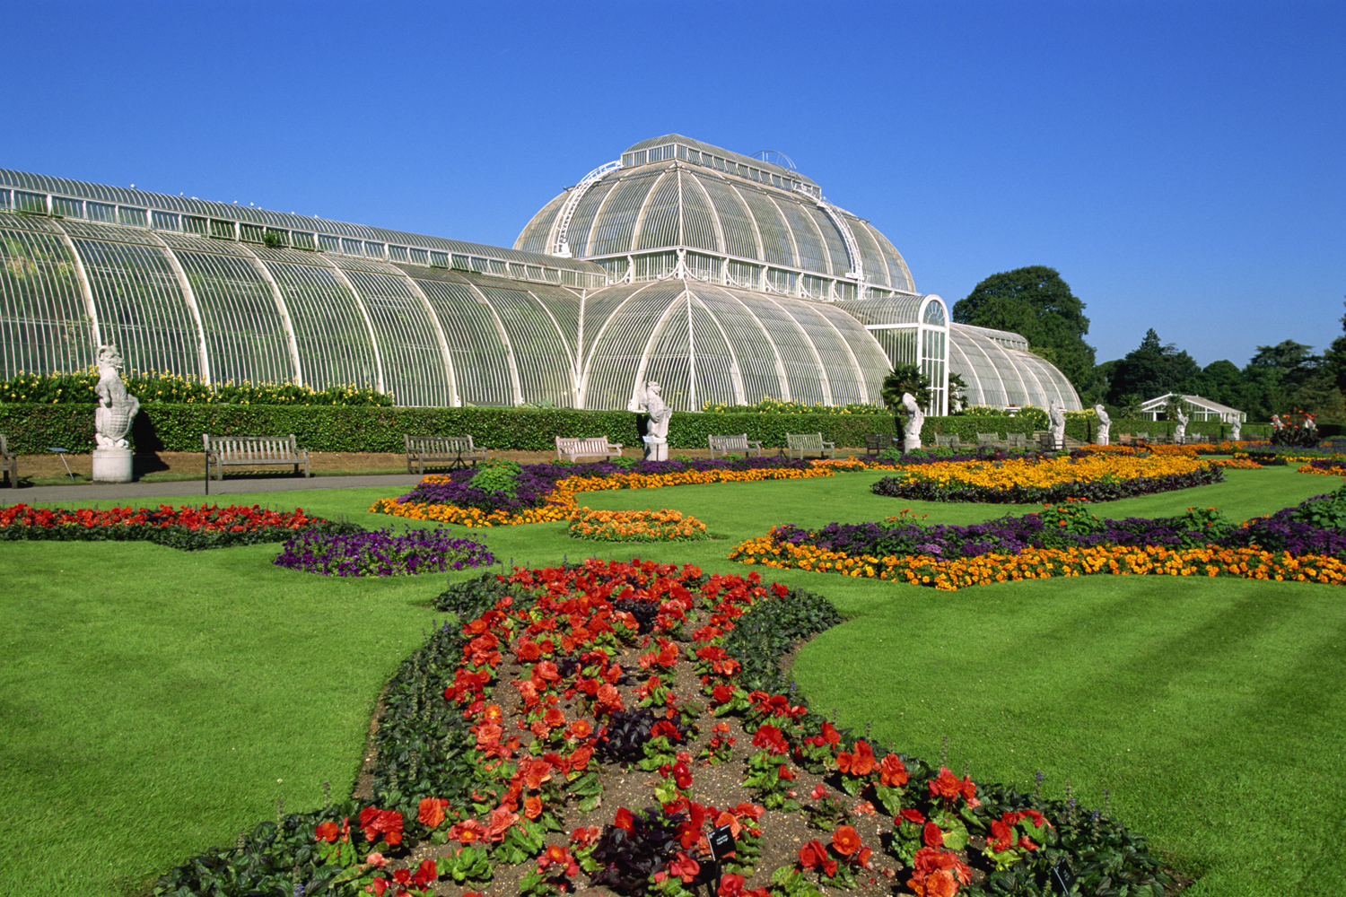

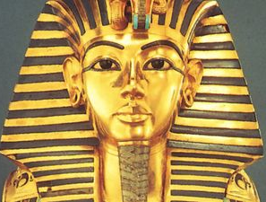
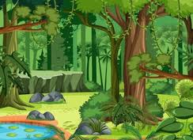

Projects - History, Geography, Art, D&T
Off with her head
Allotment
Stargazers
Time travellers
Investigating our world
Pharaohs
Notes:
Off with her head!
A focus on the Tudors.
Star Gazers
An exploration of Earth, space and forces.
Investigating Our World
A focus on the world’s rainforests, land use and map skills.
Ancient Egypt
A history focus and a science focus on forces and DT mechanisms.
Allotment
A scientific look at plant and animal life-cycles through practical activities.
Time Travellers
A look at puberty and how humans change as they age.

Slide 14
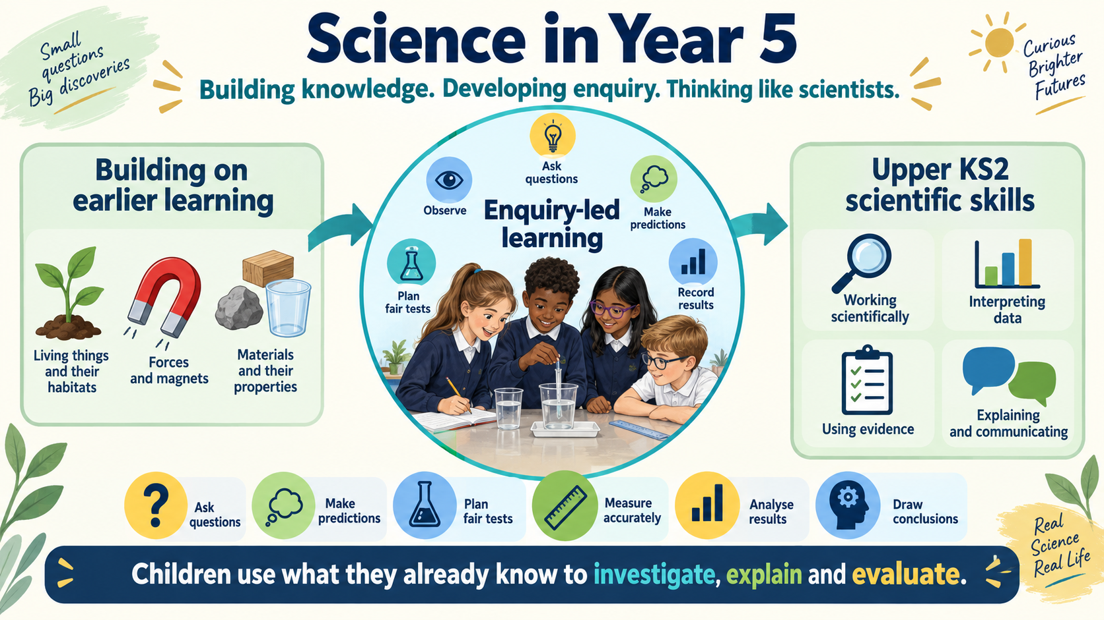

Slide 15


Slide 16
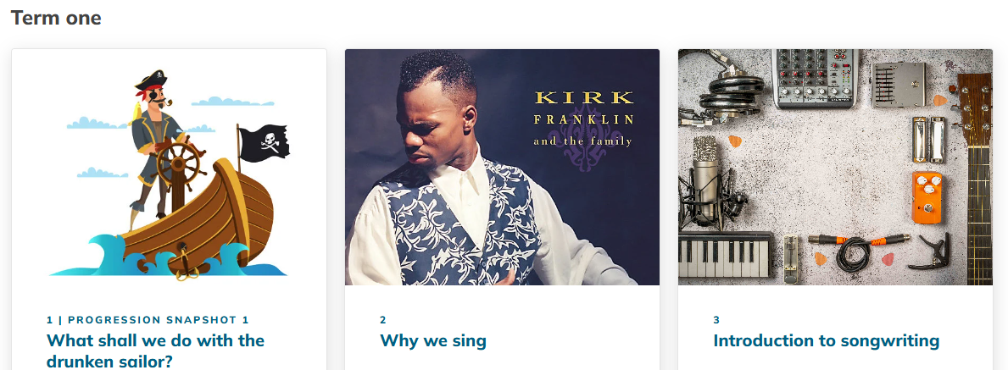
Music

Slide 17


Slide 18


Slide 19


Slide 20


Homework
  Maths –TTRS, White Rose booklets or set in a folder.
  Practise maths passport targets (Key Instant Recall Facts for maths).
  Daily reading for a minimum of 20 minutes per day - children are expected to complete their diaries at least once per week and to hand these in on a Tuesday.
  During the year, there will be half-termly topic homework
Homework instructions will be sent out weekly on Google Classroom.

Slide 21


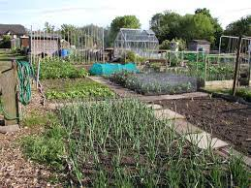
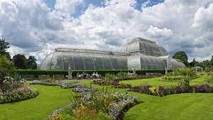
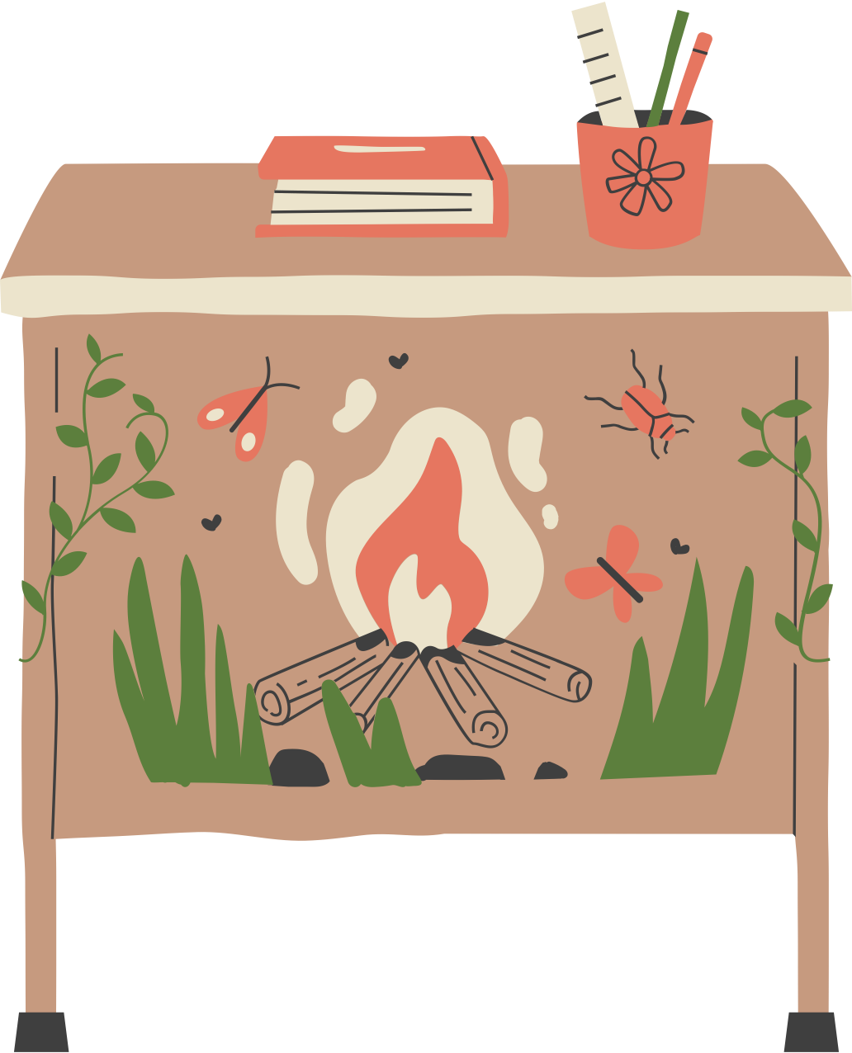
Trips…
Hampton Court Palace – Tuesday 13th October
Space Dome – TBC
Kew Gardens – TBC
Visiting local allotments

Slide 22
Online safety and safeguarding
Permission form for mobile phones (available from the office). The class teacher will collect any mobile phones at the start of the school day and return it to the child at 3:20.
Parental checks on social media. Please ensure that you monitor your child’s online activity and have appropriate parental controls in place where necessary.
Children receive regular online safety lessons in school as part of their computing curriculum.

Slide 23


Communication
Year group e-mail.
This will be your primary point of contact for all enquiries and messages to the class teachers/other members of staff.
year5@stanley.richmond.sch.uk
Project homework can also be uploaded here.
Arbor
Remember that the office is now ‘paperless’ so check Arbor regularly for newsletters, year group messages updates etc.

Slide 24


Sanctions and rewards
Rewards
  House points
  Stickers
  Class rewards
  Star of the Week award
Sanctions
First warning
Second warning
Third warning - miss part of playtime (restorative questions)
Parents will be contacted for persistent behaviours.

Slide 25

School Values Calendar
The Stanley values are as follows:
Responsibility – Autumn 1
Empathy – Autumn 2
Aspiration – Spring 1
Contribution – Spring 2
Resilience – Summer 1
Happiness – Summer 2

Slide 26
How you can help your child at home:
Share books with your child; read/discuss/enjoy.
Help your child to learn their number bonds and times tables and half-termly maths KIRFs.
Make sure your child’s clothes, PE kit, lunch box and equipment are named.
Volunteering for trips/ to hear readers.
Enable a good night’s sleep.

Slide 27
How you can help us at school:
Please sign up if you are able to give 20-30 minutes at the end of a Monday/ Tuesday/ Wednesday/ Friday to help children with reading/ maths targets.
Thank you!

Slide 28

Please contact us if you have any queries

