Slide 1

Welcome to Year 1

Slide 2
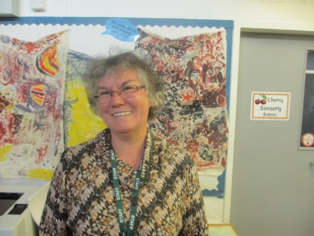
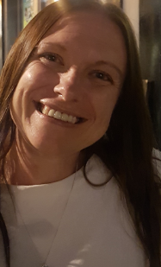
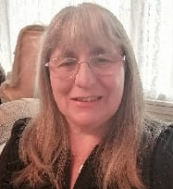
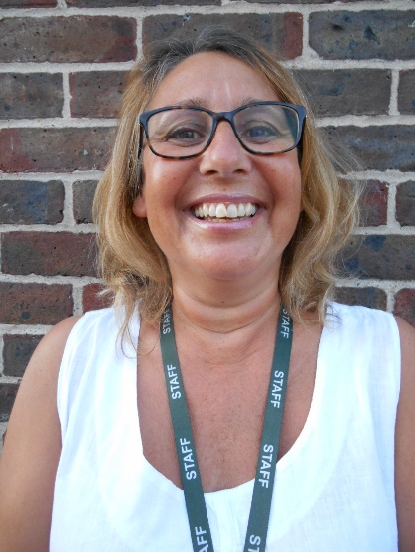
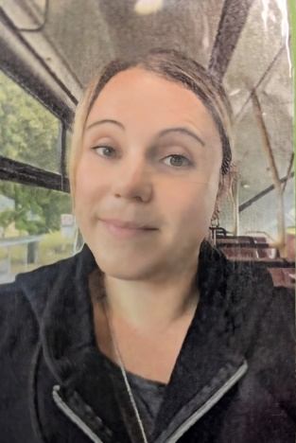
Year 1 Team
Teachers:
Teri Costello
Sarah Ringland
T.A.’s:
Maxine O Mara (ELSA)
Miss Claire
Sam Botterill
Maria Hopkins

Slide 3
Communication Methods
Tapestry
We are very lucky to be able to continue with Tapestry in Year 1 this year.
Please check Tapestry regularly – there will be frequent updates on your child’s learning. Please ‘like’ to indicate you have seen a post or completed a phonics video.
Please keep sharing your child’s out of school learning experiences. Where appropriate these can be used in class.
Parent Mail and Arbor
We use Parent Mail and Arbor as our main line of communication regarding any important information you need to know or if we need to request anything.
Please see the office if you need any support.
Year Group Email
We appreciate it is sometimes difficult to speak to teachers at the start and end of the day. This is why we are using the year group email address:
year1@stanley.richmond.sch.uk as a way to communicate with us. Please be aware that as we are teaching, we will not be able to respond during the school day, so any urgent messages need to be sent via the office.

Slide 4
General Expectations
P.E.
PE Kits – Please ensure your child comes to school wearing their regulation PE kit on PE days, which we will inform you of. Children may either wear the Stanley PE hoodie or their school jumper or cardigan over their PE kit.
If your child cannot do their own laces, please send them in either Velcro trainers or plimsolls. They will need to remove and put on their own shoes and socks when using the wall bars.
If you are unsure of the correct colour t-shirt for your child please contact the office. Please name EVERYTHING!
Water Bottles
Please ensure that your child has a named water bottle at school with them every day.

Slide 5
General Expectations
This year, we will would like you to continue to bring in book bags, reading books and reading diaries everyday which means we can change books when needed and listen to your child read as often as possible. We will collect book bags in the morning.
Reading diaries will be checked regularly.
Please be on time every day. School starts at 8.40am (register closes at 8.50am) and finishes at 3.15pm. Phonics sessions start at 8.50 so children really need to be in place by then.

Slide 6
Daily Structure
Morning – Read, Write, Inc phonics,
maths and / or English session
Afternoon – art, science, history, geography, PSHE, music, DT, PE and RE
Regular assemblies with Year 1 and 2

Slide 7
English:
We will begin the year by continuing with ‘Drawing Club’ using an inspiring text and teaching key skills. The provision is set up like ‘exploring time’ in Reception, with all activities carefully planned to fulfil the objective and contain a level of challenge.
Maths:
We are continuing our highly successful maths mastery style learning using the White Rose Maths Scheme. We are also developing children’s knowledge, visual concept of number and rapid recall.

Slide 8
Reading
Reading is a crucial part of your child’s learning in Year 1.There is an expectation that children will read to an adult for 10 minutes daily at home.
For a detailed explanation of how we teach reading please see ‘How We Teach Reading’ Powerpoint which will be available on the website and a presentation for parents will be arranged for September.
To develop your child’s love of reading there really is no substitute for reading with and to your child every day.

Slide 9
Reading
Phonics is taught through the Read, Write, Inc. programme, which has proven to be highly successful.
Children will be bringing home a book in accordance with their Read, Write, Inc. level (labelled ‘I Can’) and as they move through their reading journey, they may also take a ‘We Can’ book, which they may need more support with.
To really foster their love of books and reading, children will also be bringing home a book from the book corner that you may read to them or with them, or can be read together.
We are keen for children to develop the independence to change their book as often as needed.

Slide 10
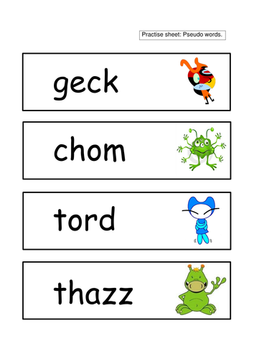
Phonics Screening
This is the only statutory assessment in Year 1 and it usually takes place in June.
Children are tested on a series of words, some real, some ‘alien’.
We encourage children to point to each sound (not necessarily each individual letter) in turn, say each sound and then blend. More details and a demonstration of how we teach phonics will take place in the presentation in September.

Slide 11
E - Safety
As part of our focus on children’s mental health and well-being we are also having a school-wide focus on E-Safety and ensuring our children understand how to stay safe online.
Here is a link to an age-appropriate E-Safety video:
https://www.childnet.com/resources/smartie-the-penguin

Slide 12

Handwriting
We use the Letter Join Handwriting Programme, here is an example of the script:
There is no expectation that children join their writing in Year 1, just that they use the correct pencil grip, correctly form and orientate their letters and that they are the correct relative size. They also should understand where and when to use capital letters or lower case. Please do not model writing in capital letters or teach children to write their name in capitals.

Slide 13
Assessment
The children are assessed formally at the end of each term in reading, writing and maths. This informs our tracking of their progress and helps us plan interventions and our teaching.
We also assess children continually to ensure all have met the learning intentions.

Slide 14
Behaviour Management
We very much wish for children to become independent and take responsibility for their behaviour. Behaviour is a choice.
Following class rules leads to excellent consequences. We have a reward system in Stanley School whereby the children receive house points. Children can receive a house point for any positive behaviours, for example: showing a good attitude to learning, having a go, demonstrating the school values etc.
The house points are logged onto a system whereby the house points for the entire school are collected. At the end of each half term, the winning house will receive a mufti day.
Whilst wishing to remain positive, if, unfortunately, children do not follow the established class or school rules, there will be consequences, such as loss of a privilege, missing some playtime etc.

Slide 15
Values
All of our teaching, rewards and behaviour management are underpinned by the Stanley School Values:
Responsibility
Empathy
Aspiration
Contribution
Resilience
Happiness

Slide 16
Creative Curriculum - Topics
The Enchanted Woodland – Science Focus
Dinosaur Planet - History Focus
Splendid Skies - Science Focus
Bright Lights, Big City - Geography Focus
Paws, Claws and Whiskers - Art / Science Focus
Moon Zoom – DT / Science Focus
Each topic has a knowledge organiser which details key learning and vocabulary. These will be sent home via Tapestry and are available on the website. Please explore them with your child!

Slide 17
Helping At Home
There is much you can do to help at home and it makes a huge difference!
Daily reading is invaluable! Little and often works well. Don’t forget to also read to your children to support their language development.
Key Words to read and spell will be sent home when we have assessed the children. These are words that have to be learned by sight. Making this into a game can help – an example is rolling a toy car over the words and reading the one it lands on.

Slide 18
Helping At Home
Writing for a purpose or linked to the children’s interests is always helpful. Looking on Tapestry will help to see what they are working on in school.
If you put any photographs on Tapestry, you could prepare your child to talk about them to their friends in school.

Slide 19

FOSP supports the school’s community, parents and our dedicated teachers to raise funds that help every Stanley child make the most of their time at primary school, give them the best possible start to their education, and create happy childhood memories that will last a lifetime.
Friends of Stanley Primary School (FOSP) is our name for Stanley’s Parent Teacher Association (PTA).
The FOSP committee meet once a term and we are always looking for passionate people who want to contribute in some way.

Slide 20

FOSP organise various activities and events throughout the year to raise funds for the school.
Parents and carers of children in each year group are encouraged to help organise events throughout the year.
There are lots of ways in which you can help: running a stall for half an hour, working behind the bar at an event or simply attending an event. Thank you!

Slide 21



How can you get involved?
Class Rep: Each class needs a Class Representative to set up a class WhatsApp group and to be the liaison between the School, FOSP and parents. By joining the group, you’ll receive up to date information about school activities and important FOSP notifications. The FOSP Class Rep Organiser will be in touch soon to support each representative. Please support your Class Rep!
Attend Events: We have a Quiz night in October and our Fireworks Night in November. Please refer to the FOSP flyer for a full list of up and coming events.
Amazon Wish List: Our teachers have put together ‘wish lists’ of items that would make a massive difference to your children’s education, above and beyond what the limited budget allows for, tailored to your child’s year group. Help us clear these lists if you can!

Slide 22
Volunteers
We always welcome any time you are able to give to come in and volunteer for a range of tasks, including preparation of resources. Your help is invaluable!
Please speak to your child’s class teacher if you are able to come in and help at any point.
If you think your child may find this tricky, we are also more than happy for you to support in the parallel class.
Any Questions?

